Slide 1
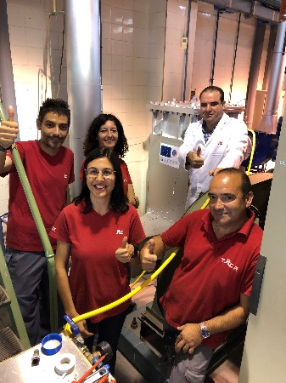
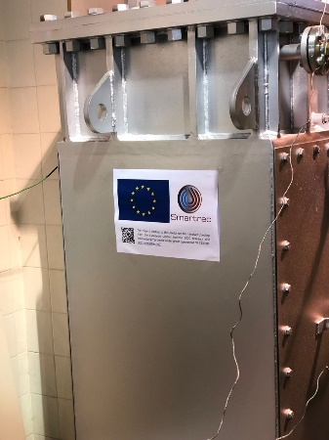
www.smartrec.eu
Smartrec Project Newsletter Issue 3 2018
Project to develop technology to capture and reuse waste heat in industry is now at the 18 month stage
This is the third newsletter from the EU H2020 Smartrec project which aims to develop technology capable of recovering at least 40 per cent of the waste heat lost in an industrial process. It is being coordinated by UK-based company ALTEK, with the rest of the consortium being made up of TWI from the UK, French Research Organisation CEA Tech, UK company Econotherm, the Spanish ITC-AICE (Instituto de Tecnología Cerámica), Italian company Spike Renewables, Greek company Innora, Norwegian company Flowphys and UK company Technovative Solutions.
The 12 month project review meeting was held meeting at CEA-TECH Genoble, France – 16-17 November 2017
The 18 month review meeting was held at Spike Renewables, Florence Italy – 25-27 April 2018
Commissioning of the first Heat Pipe system for Smartrec at ICT-AICE
During the 6 months since the last newsletter work has been progressing on several fronts of the project.
1. Installations of two Lab-scale Smartrec Systems now complete, ready for tests
2. Completed design for a full-scale Industrial Prototype for the heat recovery system is currently in manufacture
3. End User secured for the installation of the Full-scale Industrial Prototype within the Secondary Aluminium industry
4. Knowledge Software Tool developed and now live
5. Testing of materials in the chosen heat transfer fluid
6. The Dual Media Thermocline model validation on existing data from the literature is now complete.
Copyright © 2018 www.smartrec.eu

Slide 2
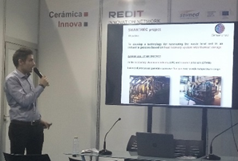
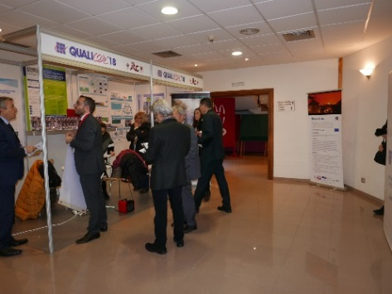
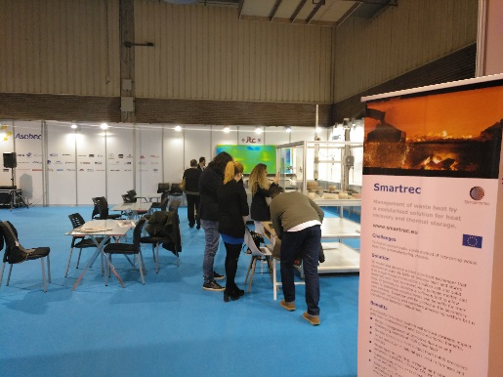
Smartrec Project Newsletter Issue 3 2018
Dissemination Activities:
ITC-AICE has produced a Smartrec brochure that was distributed at two international events related with the ceramic industry (Cevisama in Valencia http://cevisama.feriavalencia.com/en/cevisama-2018/ and Qualicer in Castellón http://www.qualicer.org/en/).
At CEVISAMA Dr. Salvador Ferrer from ITC-AICE presented on Smartrec, demonstrating its potential for an effective heat recovery in the ceramic tile process.
In the week following CEVISAMA, Castellón hosted QUALICER, the bi-annual international forum for ceramic tile. ITC-AICE has a specific booth situated at the entrance of the main conference room. Both Smartrec banner and leaflets were exhibited.
In March TWI attended the Horizon 2020 "Successful R&I in Europe" 15-16 March 2018, Düsseldorf, Germany giving a on our successful collaborative projects including Smartre.
In February Spike Renewables visited KORE Italia Srl in Rubiera Italy, where heat recovery from ceramic furncaces was dicussed and Smartrec Newsletters were left to be ditributed.
Smartrec dissemination activities
Planned work over the next 6 months:
D4.4 Report on the knowledge-based tool
D4.5 Public software tool launched
D5.1 Two HPHE units manufactured
D5.2 One DMT unit built
D5.2 Piping and Instrumentation diagram developed
D5.3 Instrumentation resources ready
D5.4 KPI definition formulated
Forthcoming events:
Spike Renewables to present at EUBCE2018 (www.eubce.com) 14-17 of May
TWI to participate and disseminate Smartrec at the Heat Exchanger Action Group in Newcastle 15th May
Altek to disseminate Smartrec at the Aluminium Industry Exhibition in Dusseldorf 9-11 of October
Copyright © 2018 www.smartrec.eu

